Slide 1
Unsynchronized Techniques for Approximate Parallel Computing
By Martin C. Rinard
Michael Wollenhaup

Slide 2
Overview
The goal of the techniques presented in this paper is to achieve acceptable unsynchronous parallel communications
These techniques are engineered to:
1. Preserve key data structure consistency constraints
2. Produce a result that is accurate enough, often enough
Because these techniques are not synchronized, they can eliminate many issues that come with synchronous parallel applications.
The class of computations the techniques were applied to contain a composite result from a variety of contributions. This redundancy enables the techniques to produce an acceptable accurate result, even if this means dropping certain contributions.

Slide 3
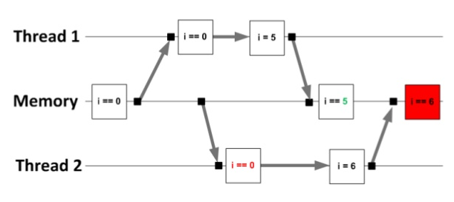
Synchronization in Parallel Computing
When multiple parallel threads want to access shared data, this can cause undesirable interactions such as data races. To solve this issue, parallel computing applications tend to implement synchronization, but there are many downsides to this such as:
Synchronization Overhead
Parallelism Reduction
Failure Propagation
Notes:
Synch: Time one task spends waiting for another
Parallelism Reduction: Synchronization forces one or more threads to wait for one another
Failure Propagation: If a thread fails, other threads will be waiting indefinitely

Slide 4
Solutions?
This paper does not attempt to eliminate undesirable interactions in parallel computations without incurring any disadvantages of a synchronous
Instead, this paper focuses on a few things such as:
Acceptability as a function of integrity and accuracy rather than correctness.
Integrity: Properties that the program must satisfy to execute successfully to produce a well-formed result.
Accuracy: How accurate does the result have to be?
Improve data races by characterizing interactions in terms of the acceptability properties of the shared data they may or may not reserve. This way, synchronization becomes necessary only in situations where it would be required to preserve essential acceptability properties. (This allows control over the amount of synchronization in the system)

Slide 5
Data Structures
The researches have identified a class of data structures that can tolerate unsynchronized updates (even when data races occur). These data structures hold the following properties:
No synchronization, No Atomicity
No synchronization overhead, no parallelism reduction, and parallel threads continue to execute regardless of what happens in other threads.
Preservation of Key Consistency Properties
Each data structure comes with standard consistency properties. Even though the unsynchronized updates may violate some of these properties, they preserve the key properties that the clients require to execute successfully
Acceptably Infrequent Interactions
In practice, non-atomic interactions (where data looses its integrity on failure) occur infrequently enough that the result rate is acceptably accurate.
Internal Integrity
The unsynchronized updates never crash or perform an illegal operation such as an out of bounds access

Slide 6
Unsynchronized Data Structure Updates
Two data structures are presented with synchronization-free updates. Two kinds of consistency properties were identified for these data structures:
History-Sensitive
Consistency properties that depend on the history of operations applied to the data-structures.
Instantaneous
Consistency properties that depend only on the current state of the data structure.
If two threads tried to add at the same time, this would result in what is normally considered a data race and concurrency error. For this paper's purposes, that would violate a history sensitive property, therefore the interaction is a semantic data race.
Notes:
If the machine has an atomic read and write, the interaction will not violate any instantaneous properties, and if the client does not require the sum to be exact and the interaction occurs infrequently enough, the add operation may provide an acceptably accurate result.

Slide 7
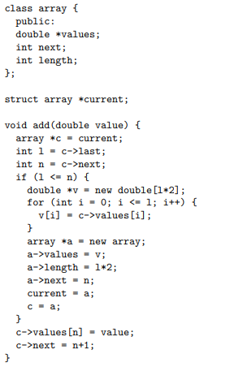
Another Example – Growable Array
Even in parallel applications, this growable array (vector) will preserve its instantaneous consistency properties (namely that current->next is less than current->length) regardless of how the writes interweave.
There are many ways the unsynchronized structure could drop added values:
Simultaneous Insertion
Two add operations can retrieve the same c->next and insert their two values into the same array element
Simultaneous Grow and Insertion
Two add operations may determine that there is no room in the current array, and both then start to execute the code that grows the array.
If these interactions occur infrequently enough, the dropped elements can have an acceptable effect on the accuracy.

Slide 8
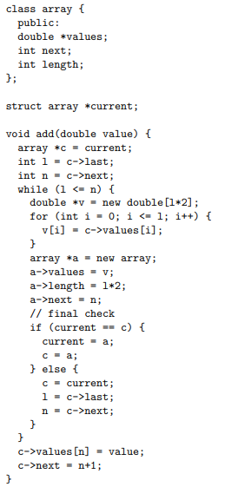
Window of Vulnerability
The time between when the add operation decides to update the data structure and the time when the update has taken place is referred to as the window of vulnerability
One way to make the window of vulnerability smaller is to recheck the original conditions of the update just before performing it. Otherwise, the operation will retry in the new state.

Slide 9
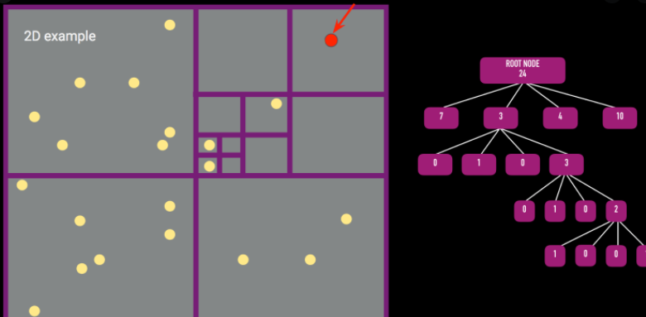
Parallel Space Subdivision Tree Construction
The ideas presented previously were used in conjunction with data structure repair, to obtain a synchronization-free parallel space subdivision tree construction algorithm for the Barnes-Hut N-body simulation algorithm.
Eliminating synchronization improves the performance of the parallel algorithm by approximately 20% with negligible impact on the overall accuracy of the simulation.
The use of final checks to reduce the sizes of various windows of vulnerability significantly reduces the number of dropped bodies.

Slide 10
Conclusion
Synchronized parallel computations can suffer from a variety of issues such as synchronization overhead, parallelism reduction, and failure propagation.
This paper presented a set of techniques to achieve similar results without the need for a synchronized system
Although these techniques within the paper have shown success, there is a struggle to find use within the “current rigid value system”, which condemns techniques as unstable, even though the execution is successful.

Slide 11
Example Questions
An out-of-bounds error would be an example of a violation of what type of consistency property?
A) History-Sensitive
B) Instantaneous
C) History-Insensitive
D) Overflow Prevention
Which of the following is not a downside to synchronized parallel computations?
A) Windows of Vulnerability
B) Parallelism Reduction
C) Synchronization Overhead
D) Failure Propagation

